Slide 1
VISITORS MANAGEMENT SYSTEM

Slide 2
ABSTRACT
Visitor Management System deals with the security provided atcompany premises from the unauthenticated or unwanted visitors.Nowadays, in most organizations Visitor management consists of visitors?scribbling their name in a paper book.Instead, Company Visitor Management System will assist you the professionalizedway in which you welcome your visitors. This software is a complete VisitorManagement service to improve the efficiency, productivity, security

Slide 3
introduction
Visitor Management system is a web-based technology that willrevolutionize the way your company manages visitors. Visitor Managementsystem is more important to security guards or security company. This webapplication provides a way to effectively control record & track company visitortraffic.In CVMS we use PHP and MySQL database. This is the project which keeps recordsof visitors who visited in the company.CVMS has one module i.e. admin1.Dashboard: In this sections, admin can briefly view how many visitorsvisited in a particular period.2.Visitors: In this section, admin adds new visitors by filling their informationin add visitors sections and also view and manage visitor’s records. Adminalso put visitors out time in the manage records section.3.Search: In this bar, admin can search a particular person by their name andphone number.4.Reports: In this section admin can generate visitor’s reports between twodates.Admin can also update his profile, change password and recover password

Slide 4
HARDWARE SPECFICATION
Processor : P 4 700 GHz.
RAM : 4 GB RAM
Hard Disk Drive : 180 GB

Slide 5
SOFTWARE SPECIFICATION
Operating System : Windows 7/8/10
Front End : JAVA
Back End : SQL

Slide 6
EXISTING SYSTEM
Existing system is based on desktop application work and all the process are done through desktop application, so they maintain several database registers for recording all the details of the system. They maintain several registers for recording the entry of daily transactions such as visitors visited, visitor pass, etc.
They maintain the record of the visitors so they keep entire information regarding the visitor in the visitor master file. In the similar fashion they maintain the records of their visits so they keep entire information regarding their visits in the visit master file. They keep the visitor book to maintain the record for the visits. They maintain the register or book for visitor information, visitor list, check in and checkout information and all the things are done with the help of desktop application.

Slide 7
PROPOSED SYSTEM
The desktop application system is to be computerised in order to overcome the problems, which affects the existing desktop application system. Computerising the existing system with the help of some programming language, database package ease the work of the system up to a great extent.
Generally, there has been a criterion to work on any job or task for a specific purpose. Nobody works without specific detailed information about the particular task he is performing. Thus, any transaction can be performed either or check in and check out. In the computerised system, the first screen of the system would be a welcome message and a list of menus.

Slide 8
types of modules
1. Admin login
2. Sign up Employees
3. Add / Manage Department
4. Employee Details
5. Visitors Report

Slide 9
Modules
Admin Login
Admin only can access this application, they have to use their credential to login into the application. Admin has unique username and password to access login. If the user given wrong username or password this application should not allowed to access an application.
Signup Employees
Admin login into the application and has access to create/signup the employee details. when the records are inserted the records will be stored in a database table, the name is an employee. employee details contains name, gender, phone number, age email and department details.

Slide 10
Add/Manage Department
Department module has used to select the department list when the employee signup page has department option. Created department details are displaying in a employee signup page.
Employee Details
This module will shown the employee details whom create the employee registration page. This page will be shown the details of employees as name, gender, age, phone number, email options.
Visitors Report
This module basically showing all the report about the visitors management, we have an option to select from and to date to manipulate the application. This is an main module of an application when the user wants to take an print out or download the records it could be also possible.

Slide 11
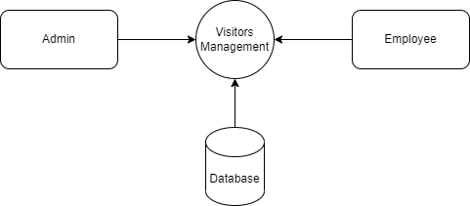
Data Flow Diagram
Level 0

Slide 12
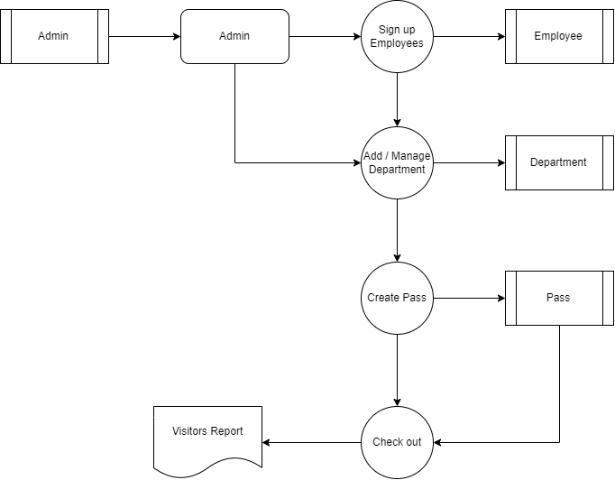
Level 1:

Slide 13
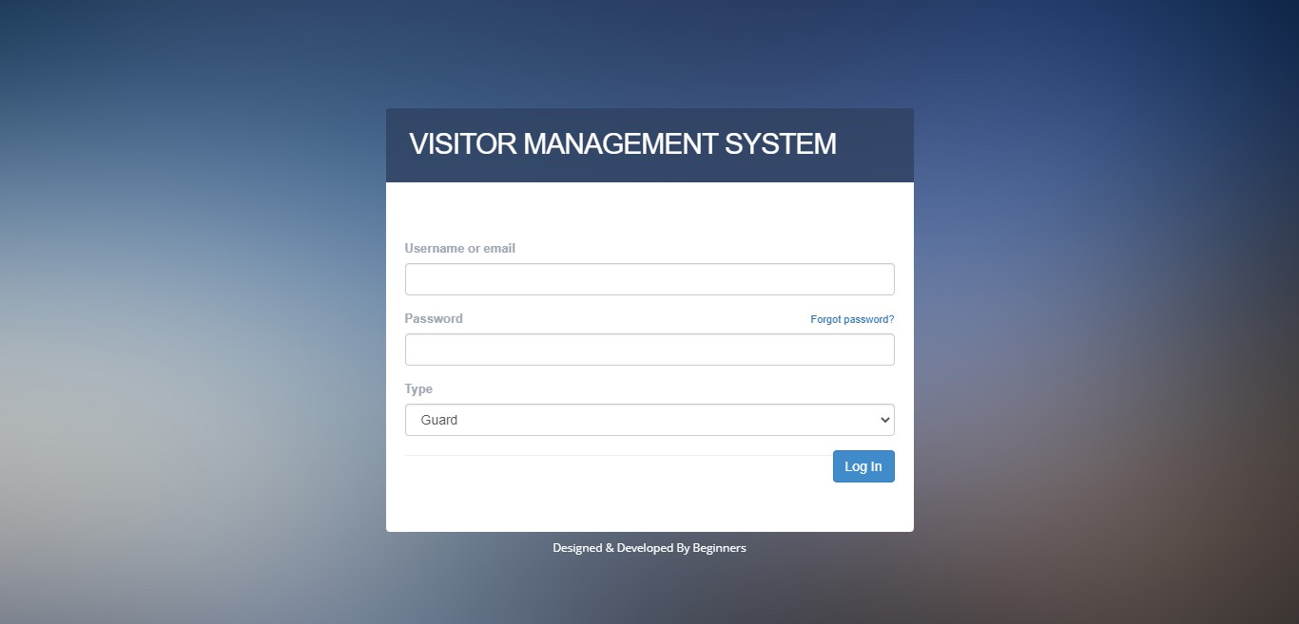

Slide 14
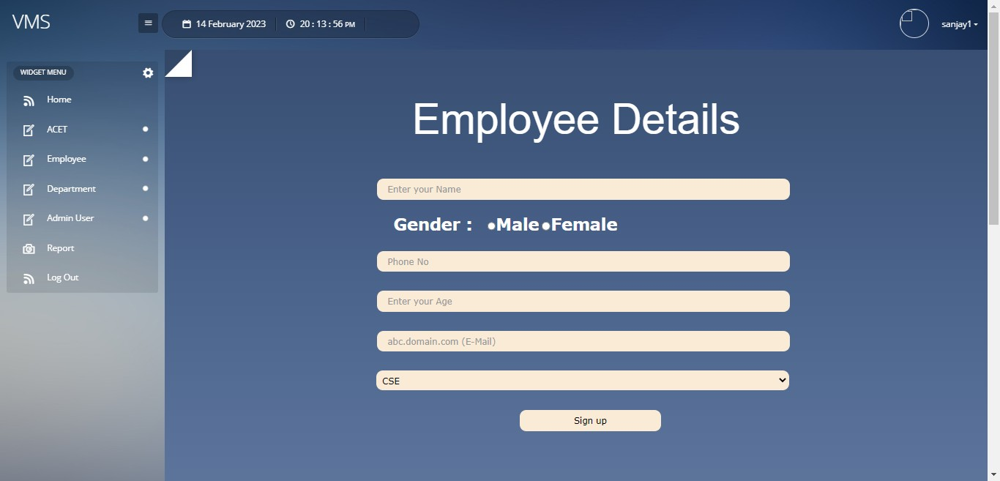

Slide 15
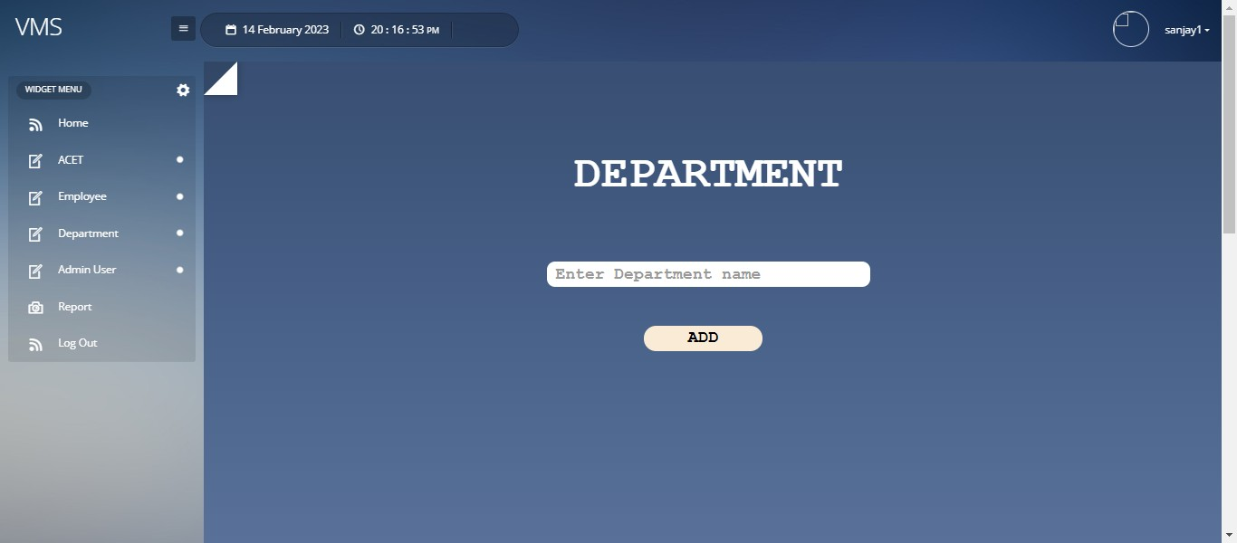

Slide 16
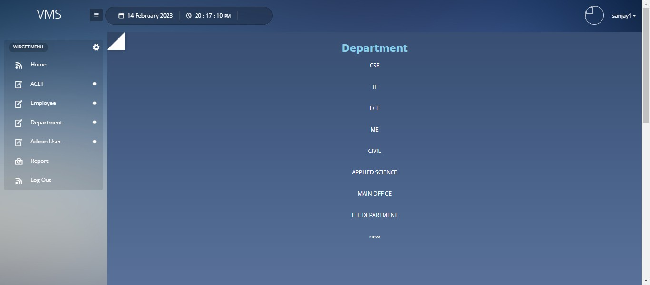

Slide 17
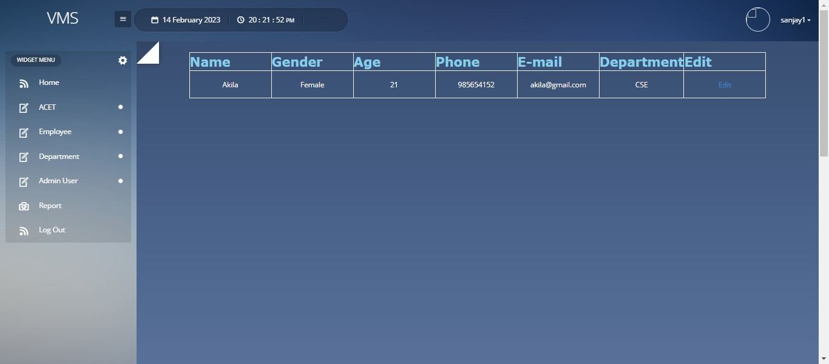

Slide 18
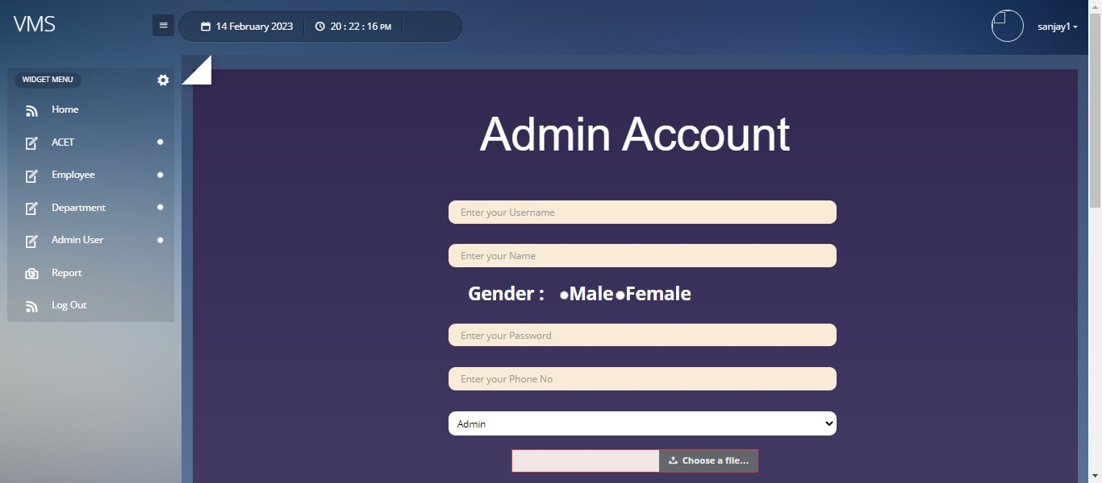

Slide 19
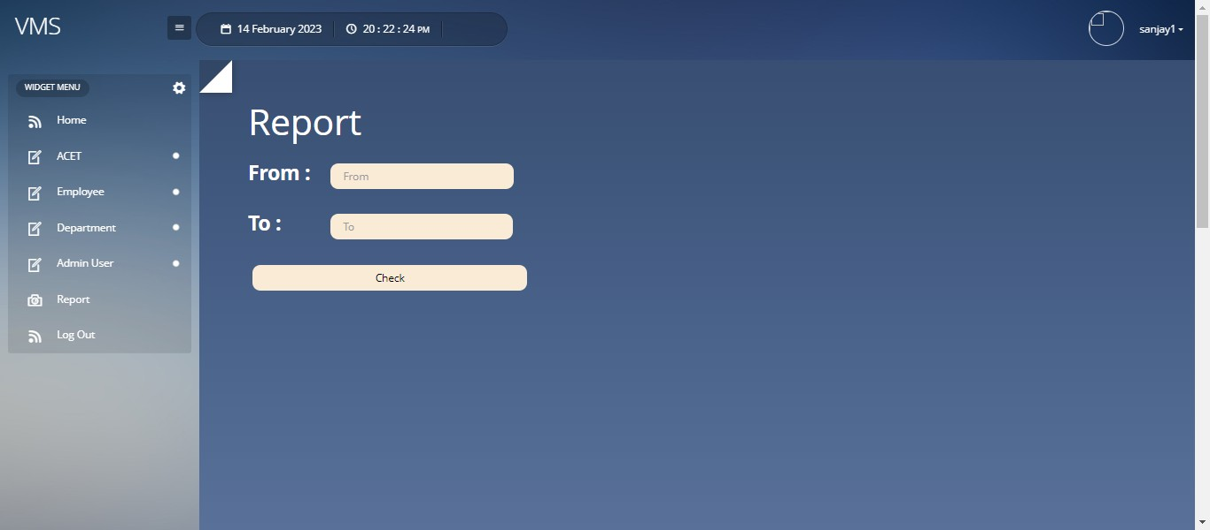

Slide 20
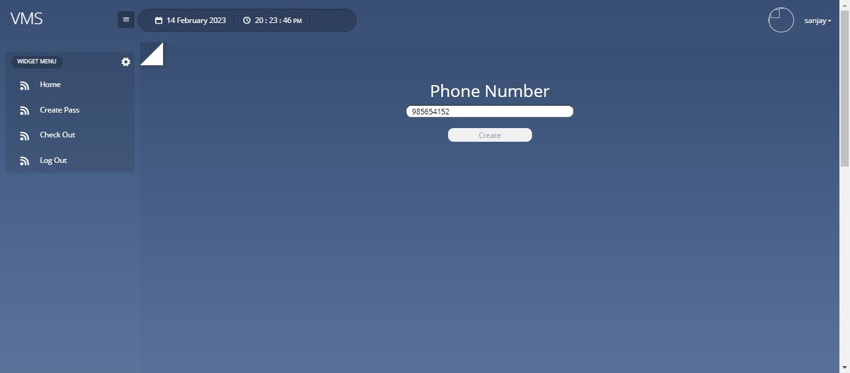

Slide 21
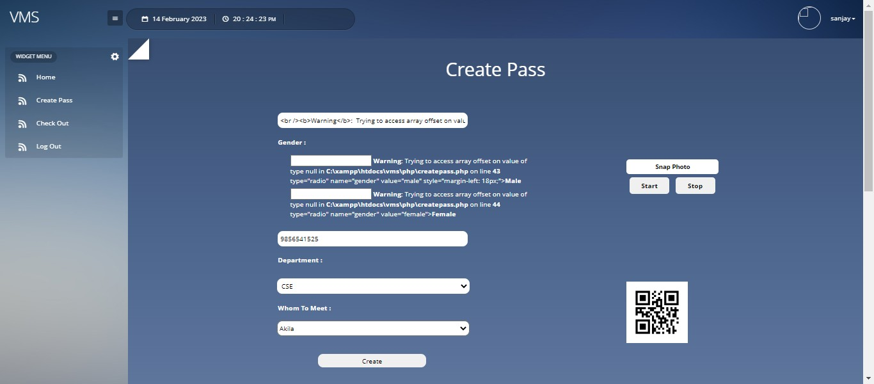

Slide 22
Thank You

